Slide 1

Organizing Business & Entrepreneurial Finance
Notes:
Arya kumar page no 577.

Slide 2
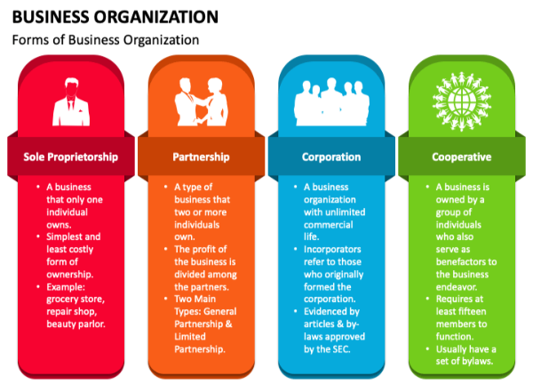

Slide 3
Types of Organizational structure
Line Organization structure
Functional Organization structure
Line and staff organization structure
Matrix organization structure
Committee organization structure

Slide 4
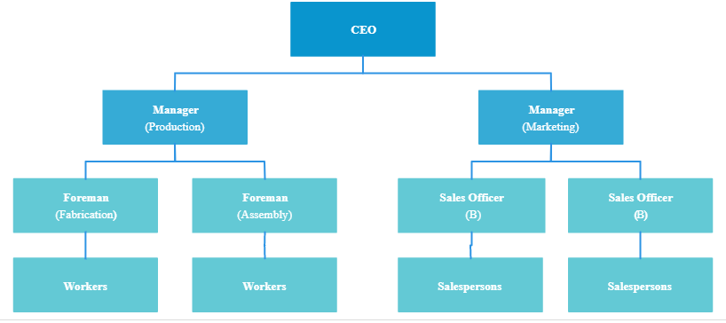
Line Organization structure

Slide 5
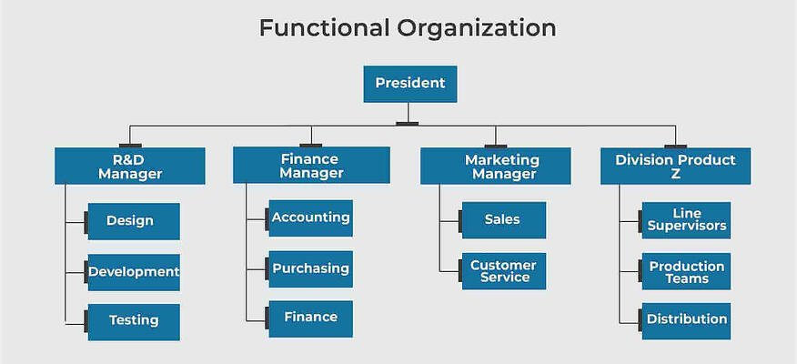
Functional Organization structure

Slide 6
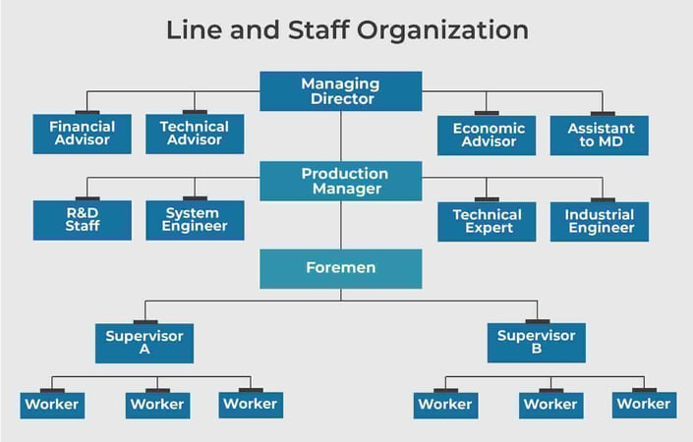
Line and staff organization structure

Slide 7
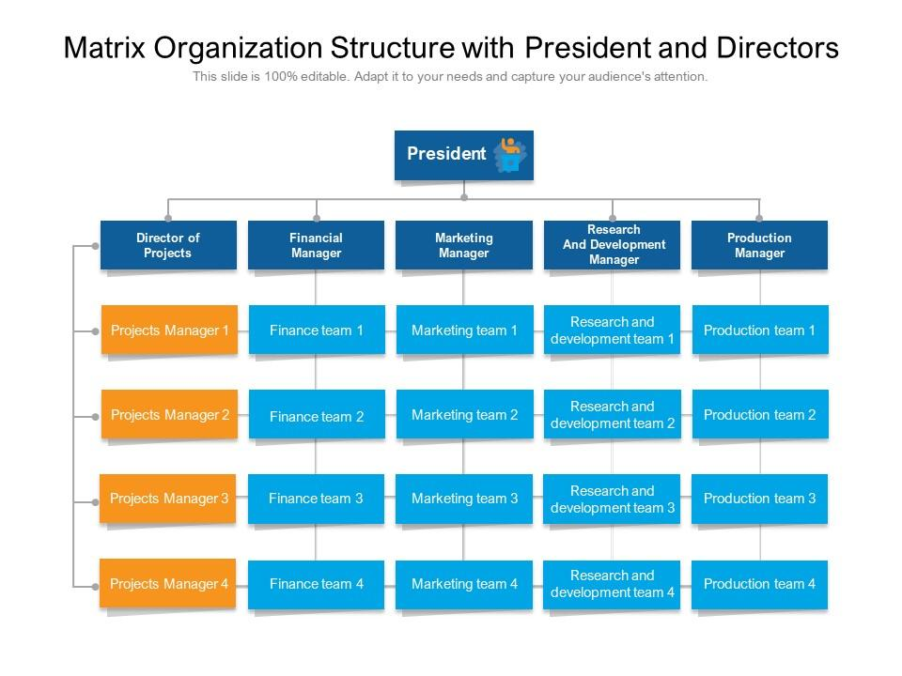
Matrix organization structure

Slide 8
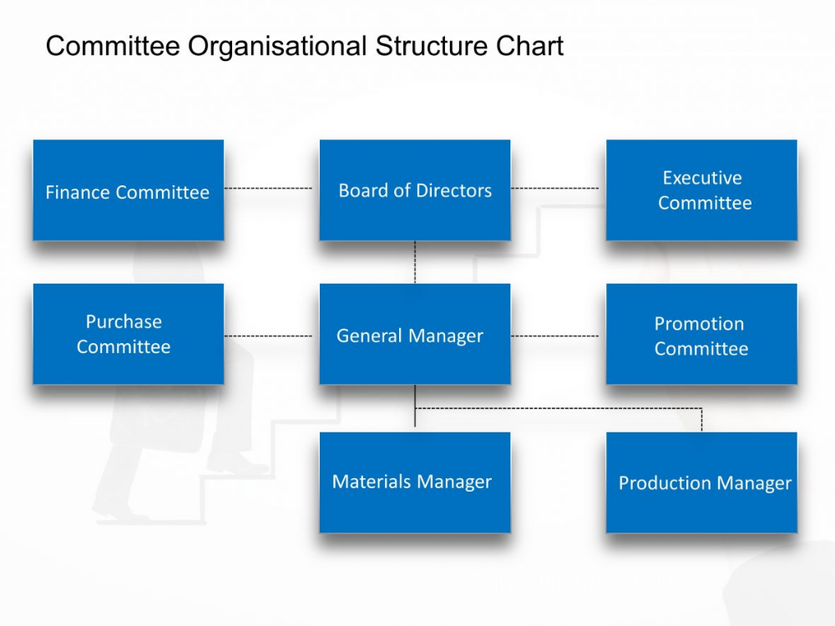
Committee organization structure

Slide 9
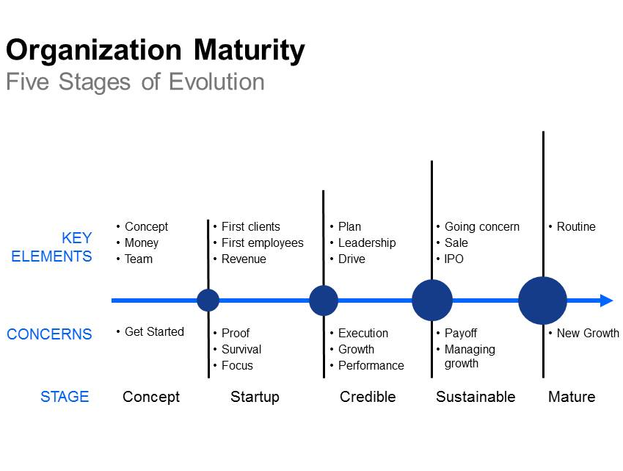
Evolution of Organization
Notes:
https://intelliven.com/five-stages-of-organization-key-characteristics-concerns/
https://www.forbes.com/sites/tanotofoundation/2022/11/09/tanoto-foundation-a-multi-stakeholder-approach-is-key-to-reducing-stunting-in-indonesia/?sh=365e293e632d

Slide 10
Sources and Selection of Venture Finance Options and its Managerial Implications.
Notes:
Arya kumar page no 577.

Slide 11
Sources of Venture Finance
Bootstrapping
Trade Credit
Customer
Manage your expenses and cash Flow well
Real Estate
Equipment Suppliers
Notes:
Arya kumar page no 577.

Slide 12
Sources of Venture Finance
Seed Funding
Angel Investor
Where to look for Angels funding
Seed support system – Technology Development Board
Corporate Angels
Entrepreneurial Angels
Enthusiast Angels
Micromanagement Angels
Professional Angels
Notes:
Arya kumar page no 577.

Slide 13
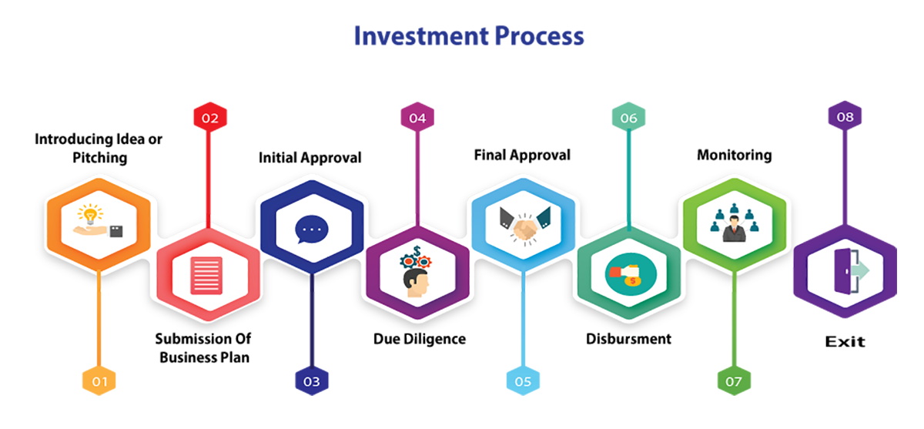
Sources of Venture Finance
Venture Capital Funding
Notes:
Arya kumar page no 577.

Slide 14
Sources of Venture Finance
Selection of Venture Capitalist
Line of business
Geographic Preferences
Deal Size
Leadership status
Stage of development
Notes:
Arya kumar page no 577.

Slide 15
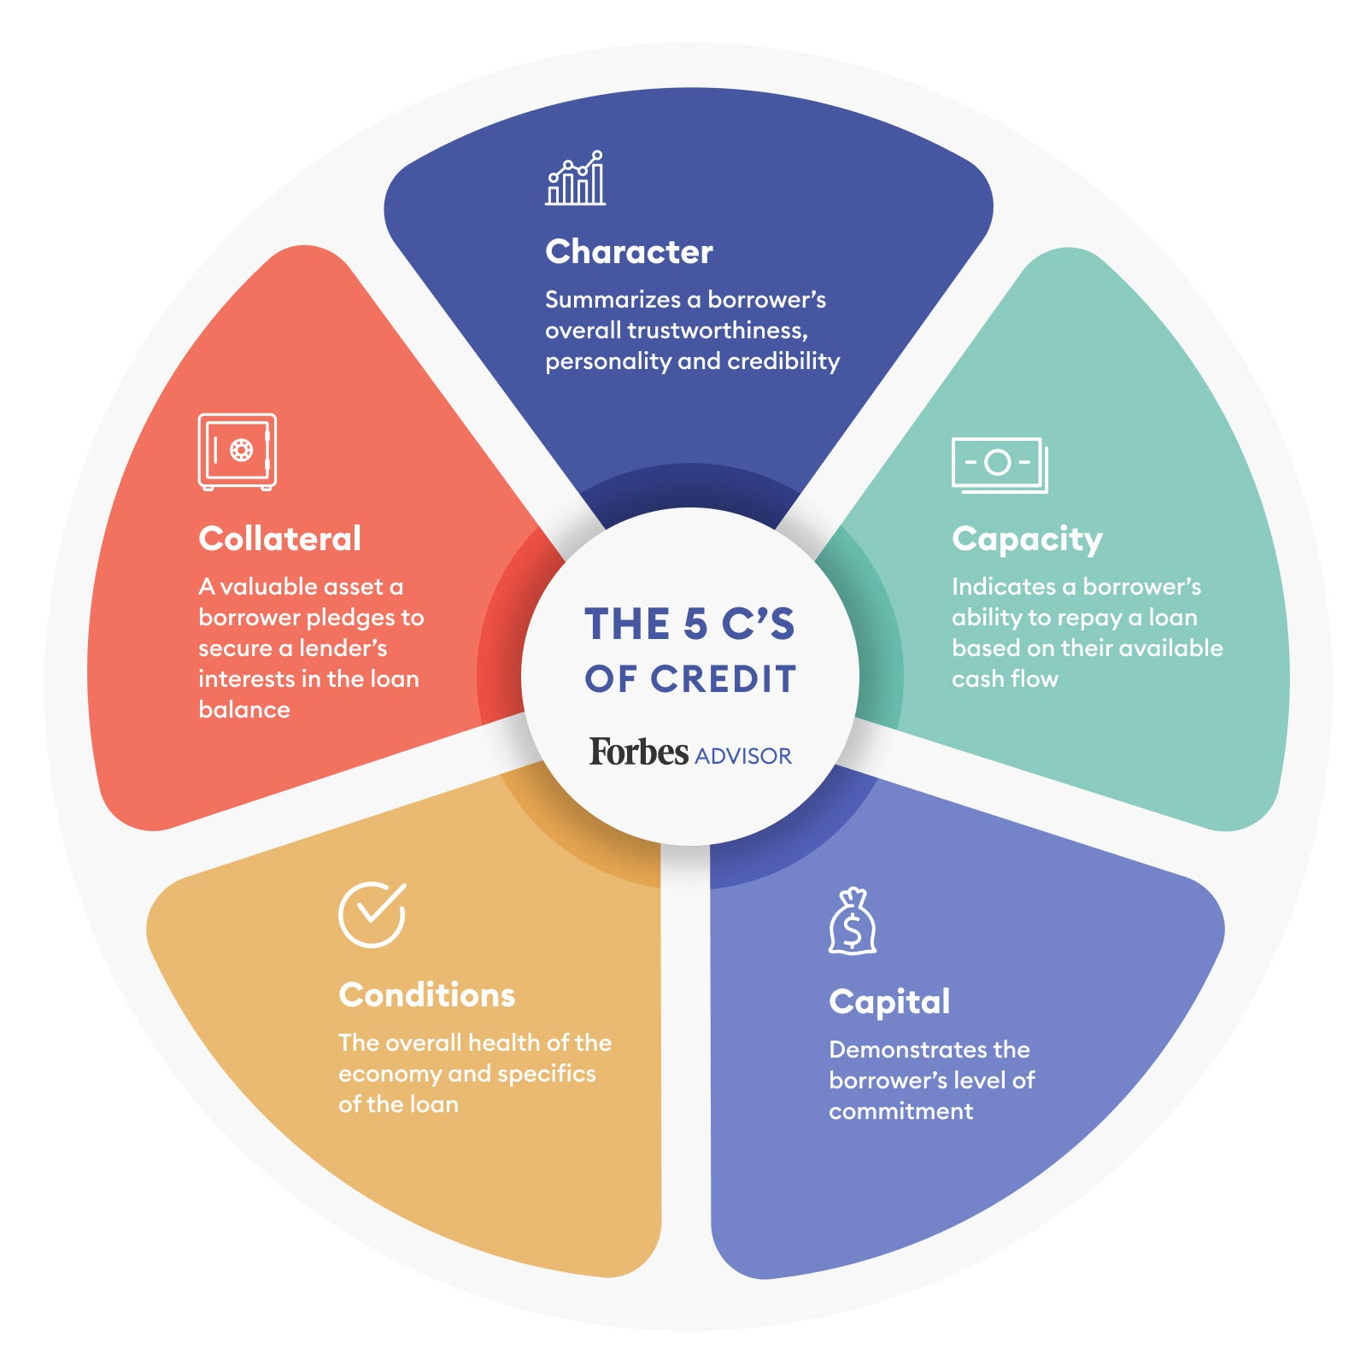
Sources of Venture Finance
Notes:
Arya kumar page no 577.

Slide 16
Sources of Venture Finance
Bank Loan
Working capital financing
Factoring
Overdraft
Bills Discounting
Banker’s Acceptance
Line of credit
Packing credit
Notes:
Arya kumar page no 577.

Slide 17
Sources of Venture Finance
Non Fund based Limits
Bank guarantee
Letter of credit
Deferred payment gurantee
Notes:
Arya kumar page nlo 580

Slide 18
Sources of Venture Finance
Lease financing
Minimising initial capital investment
Flexibility in Availing Funding
Better cash flow Planning
Provide greater Liquidity
Notes:
Arya kumar page nlo 580

Slide 19

Thank you

